Slide 1

Mimir: A Password Manager Project
By Edward Bennett

Slide 2
Problem statement
Online security has grown increasingly important
Longer and more complex passwords are better – but harder to remember
Passwords should also be reused as little as possible
Remembering complex, unique passwords for each accounts just isn’t feasible
Enter: password managers

Slide 3
Aims and Objectives
Password managers allow a user to access all their passwords from one “master” account
This means they only need to remember one strong password
Create a password manager which can be used to store and manage online account details
Should be preferable to poor password habits or trying to remember many complex passwords – thus must be usable

Slide 4
Requirements
Requirements identified using the MoSCoW method, literature review, and review of existing products
Must have:
Allow users to store, retrieve, update, and delete password records
Allow users to search for specific records
Generate strong passwords
Create and log into a master account

Slide 5
Requirements
Should have:
A folder system to organise records
A master password hint can be offered to remind the user of a forgotten master password.
The user’s password is stored as a hash.
The passwords on the database are encrypted.
The application should use HTTPS over HTTP.

Slide 6
Requirements
Could have:
If a user makes a certain number of unsuccessful attempts to log in in a row, they are locked out of their account for one hour.
The user receives a verification email upon sign-up to verify their account.
The user can store secret questions to be used in the event their password has been forgotten and their account needed to be recovered.
The user can select an alternative colour palette.

Slide 7
Requirements
Won’t have:
The user can store custom fields in a record.
Security evaluator.
Two-factor authentication.
Biometric authentication.
Physical security key authentication (such as Yubikey).

Slide 8
Solution Approach
Javascript Web Application
Built using the MERN software stack (MongoDB, Express, React, Node)
Designed as a RESTful API

Slide 9
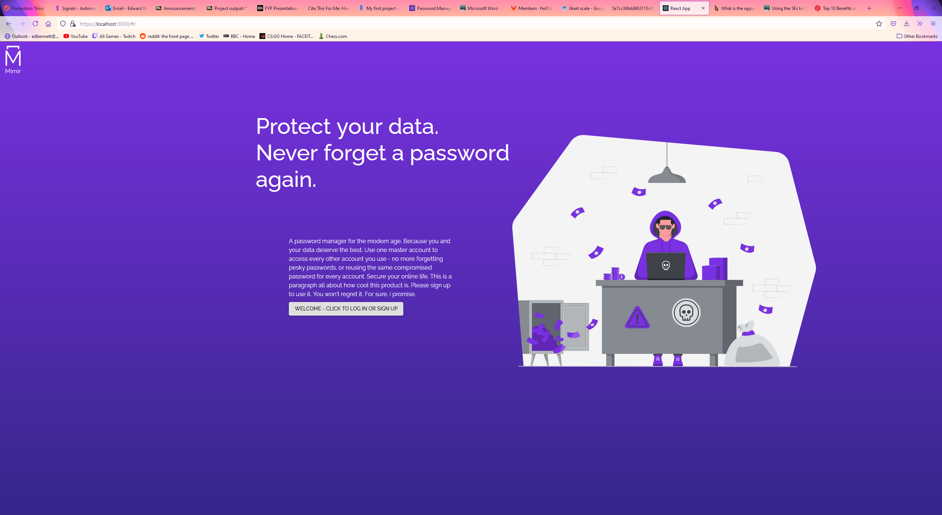
Front Page

Slide 10
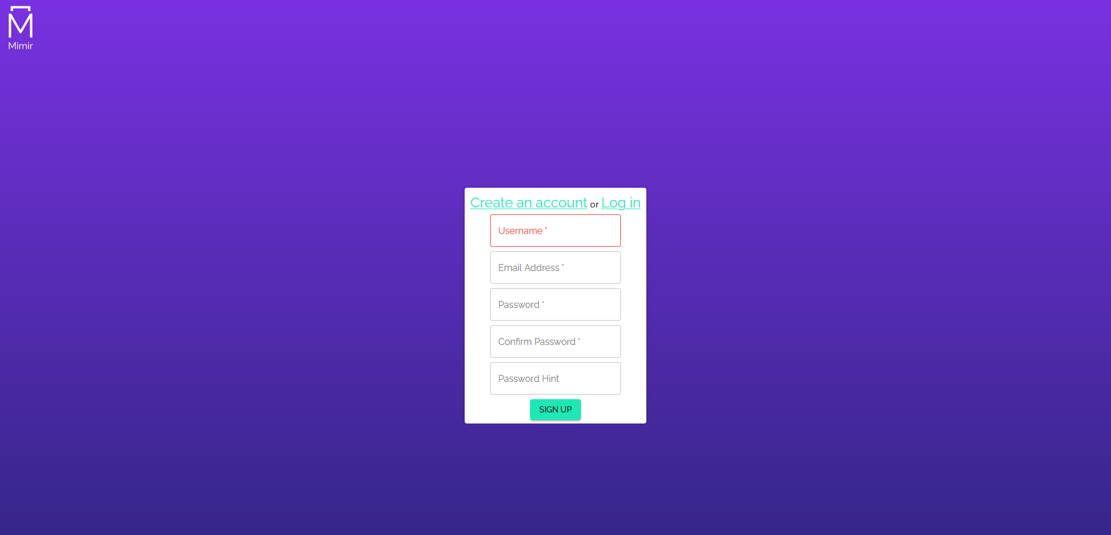
Sign Up Form

Slide 11
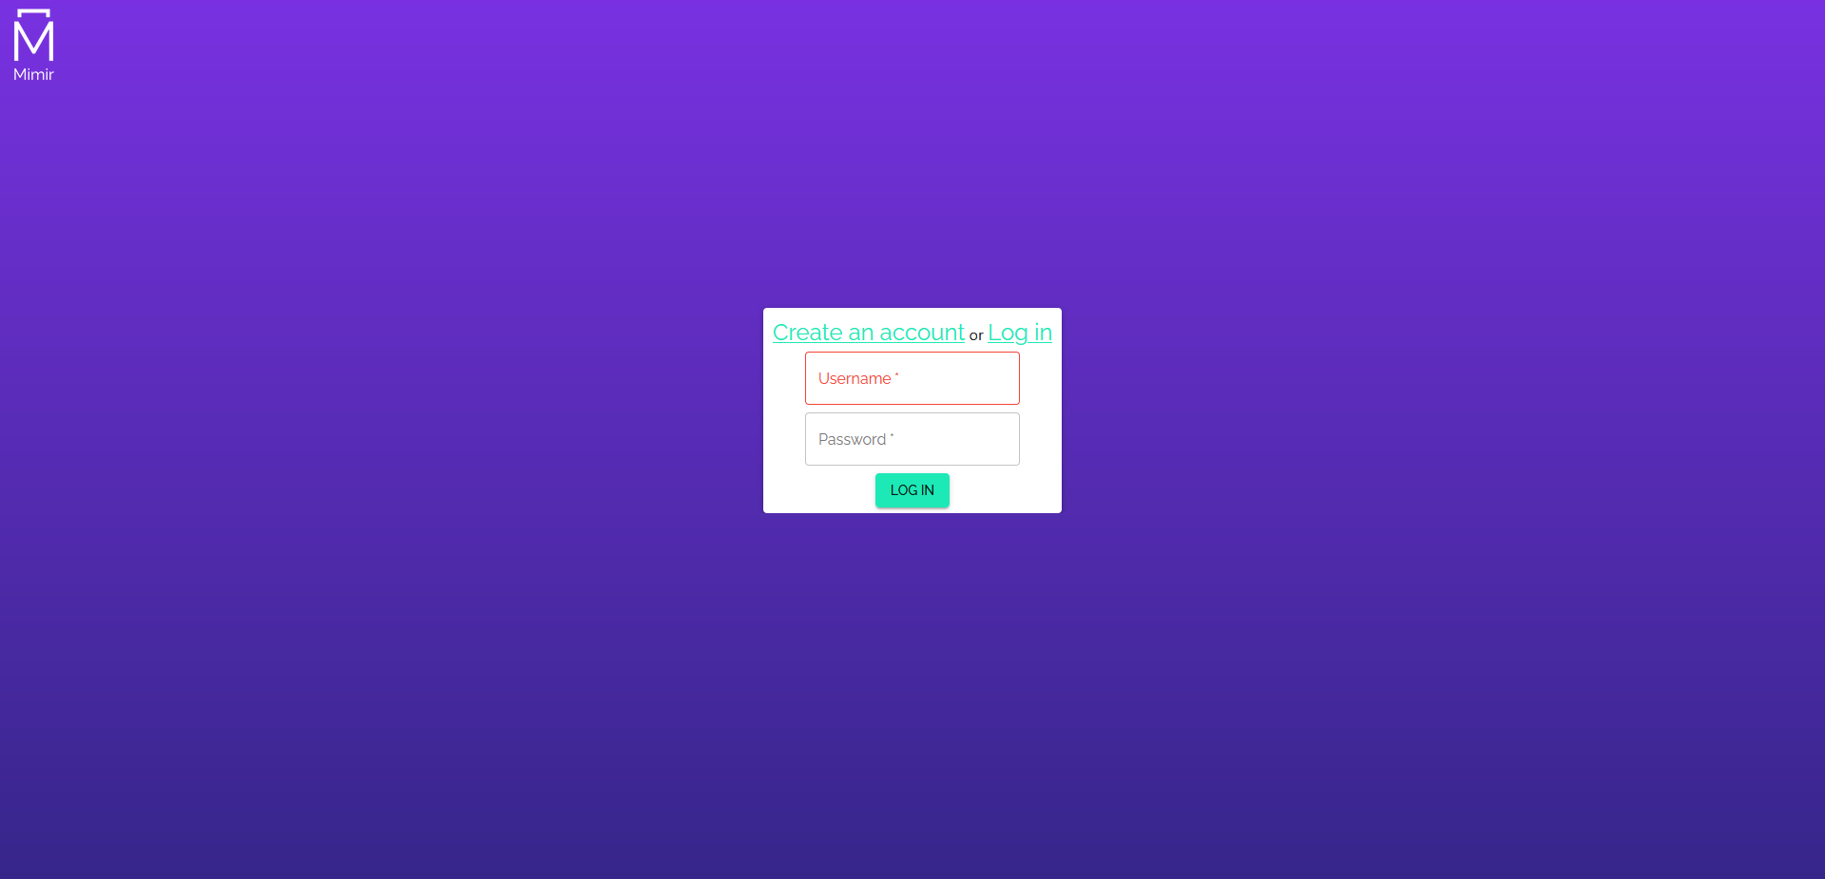
Log In Form

Slide 12
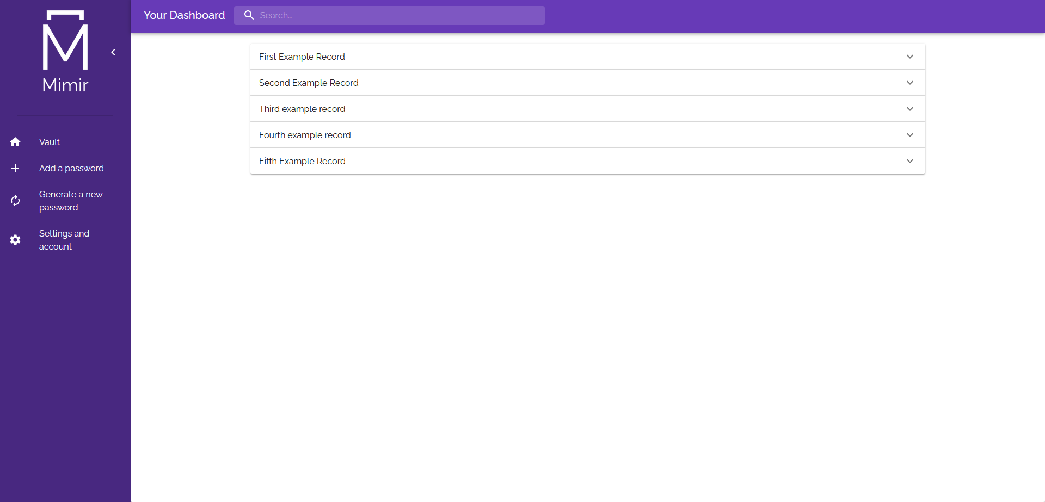
Dashboard

Slide 13
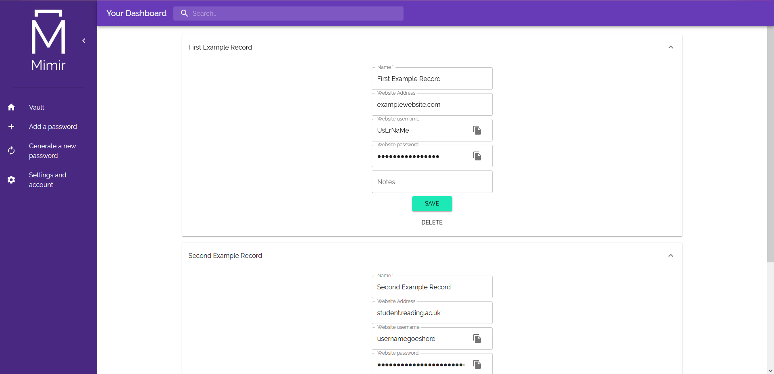
Dashboard

Slide 14

Dashboard

Slide 15

Dashboard

Slide 16

Add a New Record

Slide 17
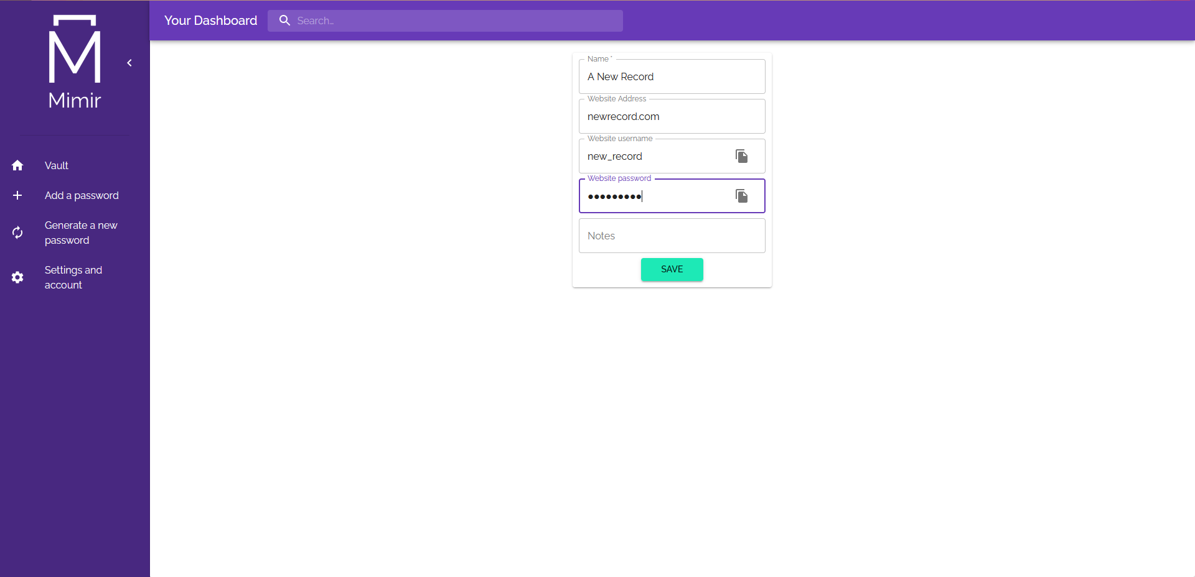
Add a New Record

Slide 18
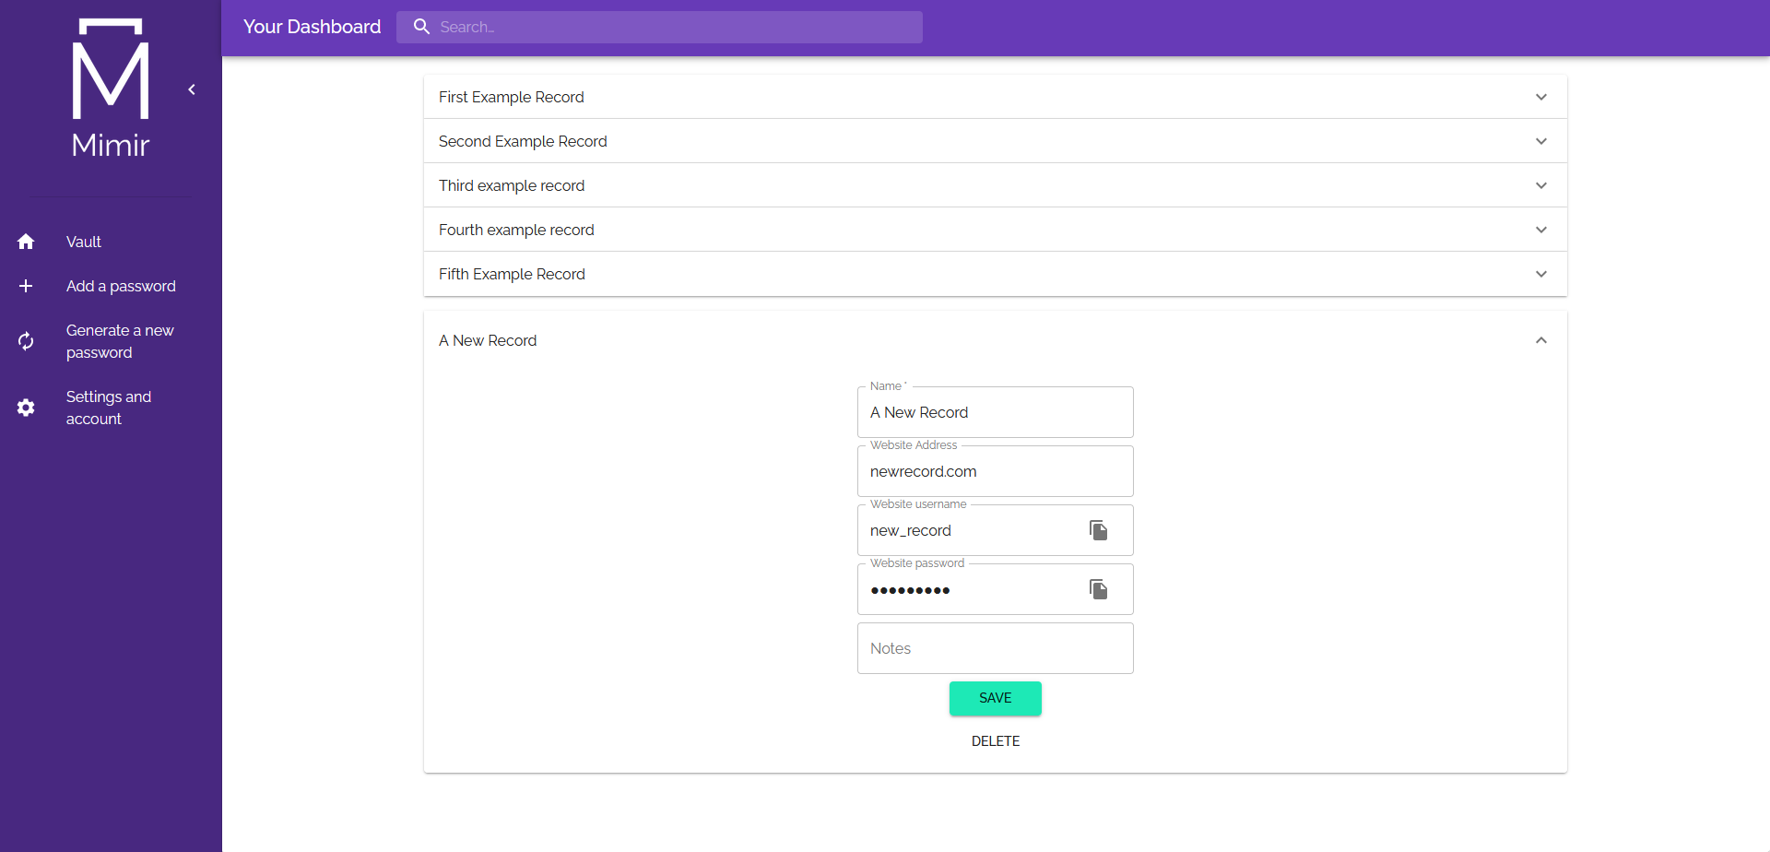
Add a New Record

Slide 19
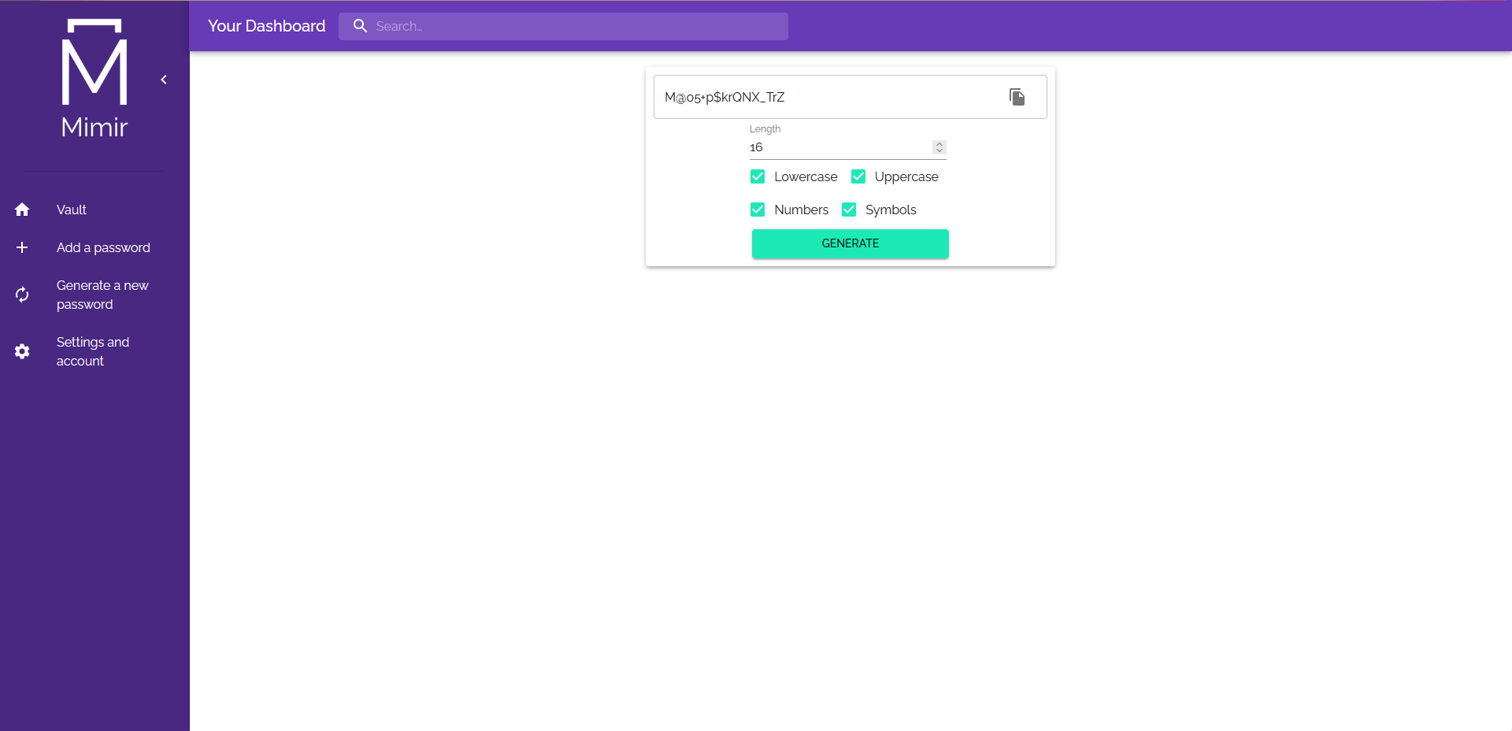
Password Generator

Slide 20
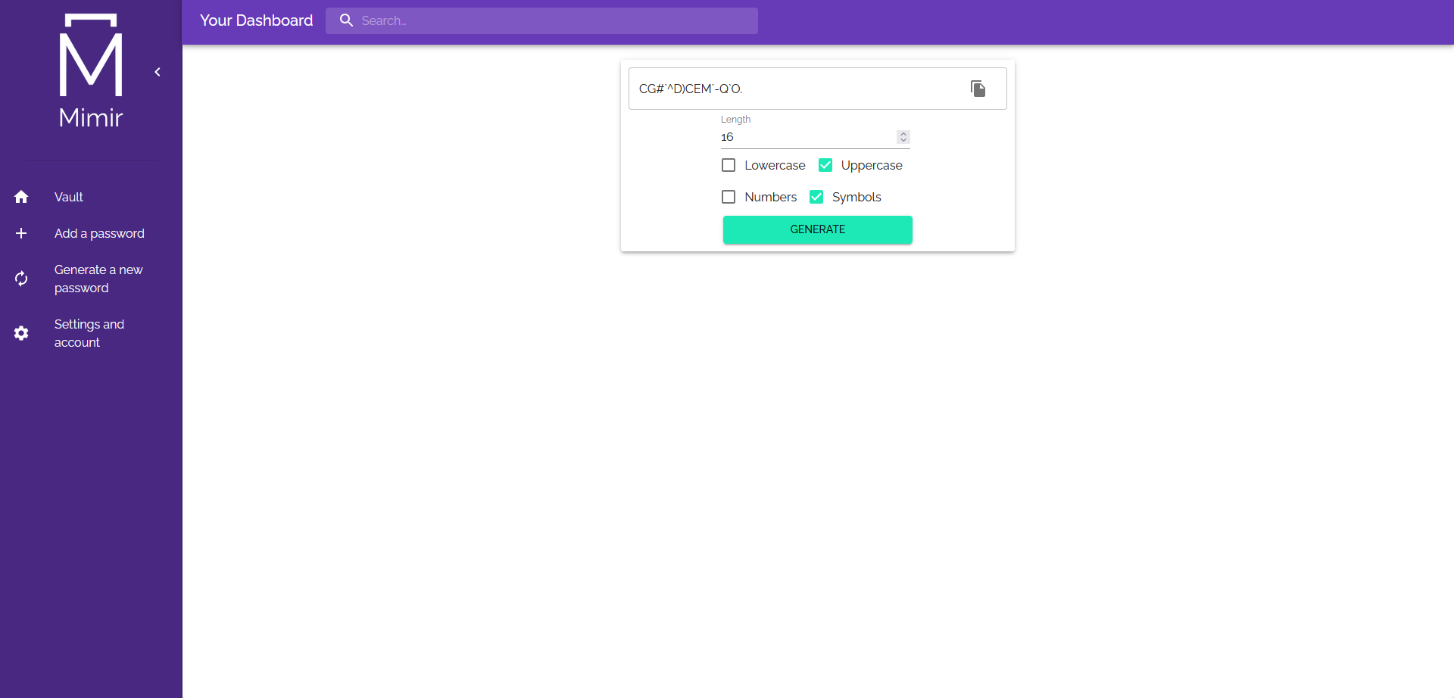
Password Generator

Slide 21

Password Generator

Slide 22

Account Settings

Slide 23
Evaluation and Conclusions
Once complete the project was presented to users and they were asked to fill out a feedback questionnaire
Used the user feedback to evaluate the project and determine its usability – one of the key aims
Not much less convenient than not using a password manager
More secure
All essential requirements and many nonessential requirements were included
Determined to be mostly successful

